Slide 1
Machine Learning
(Neural Network)
Machine Learning Definition
Perceptron
Feed-forward NN Architecture
Backpropagation

Slide 2
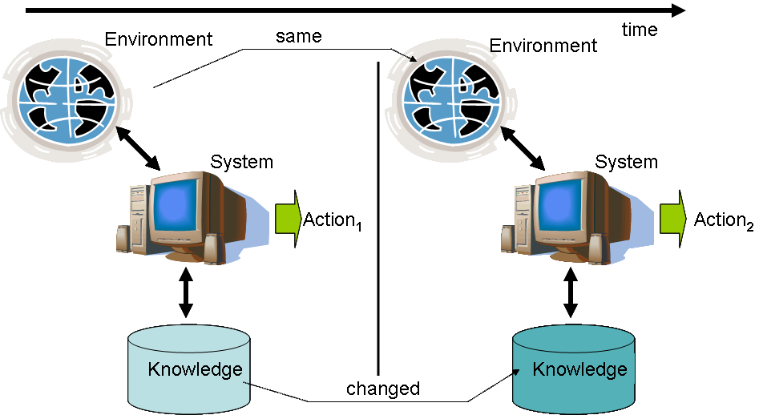
What Is Machine Learning?
“Logic is not the end of wisdom, it is just the beginning” --- Mr. Spock

Slide 3
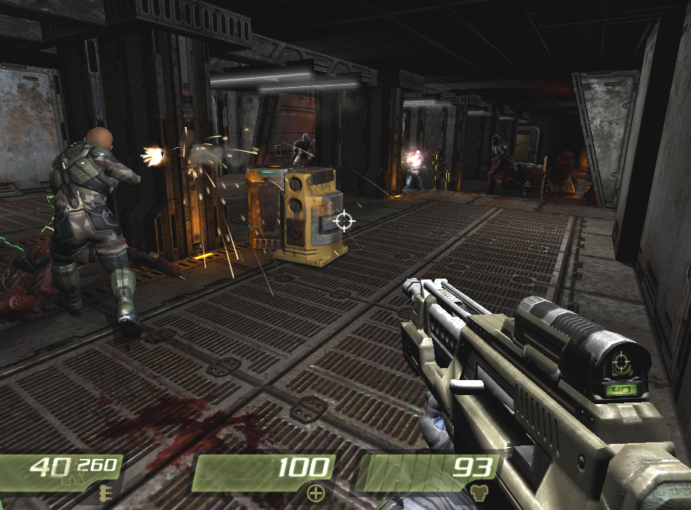
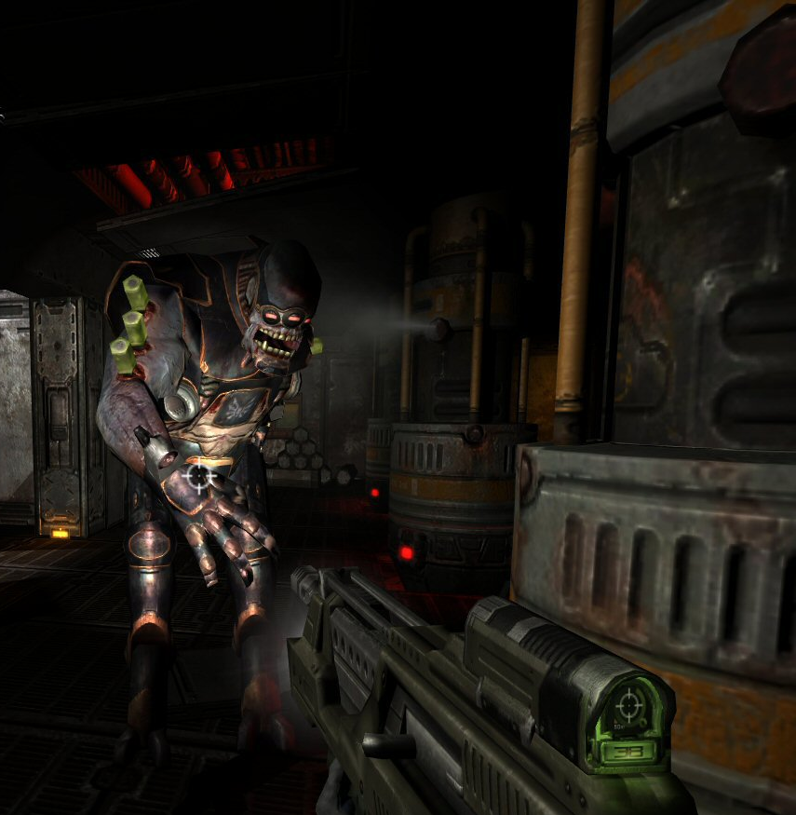
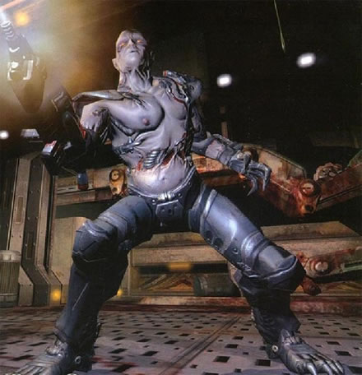


Game Playing
Chase
Retreat
Spawn
Wander
Attack
Low Health
Sound
Dead
Enemy

Slide 4
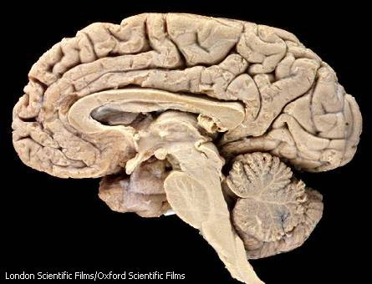
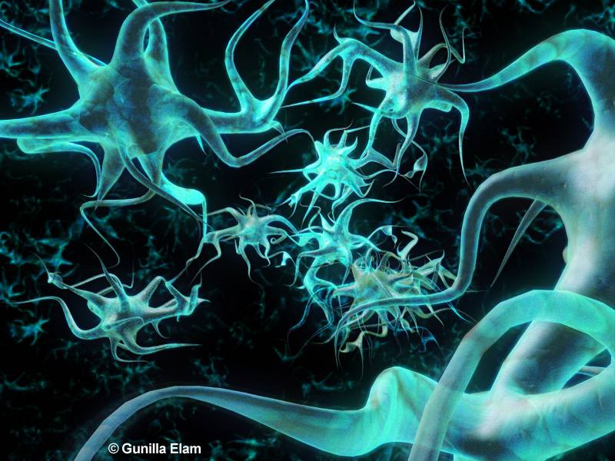
Neural Networks
Biological approach to AI
Developed in 1943 (McCulloch-Pitts)
Comprised of one or more layers of neurons
Several types,
  we’ll focus on feed-forward networks

Slide 5
Usefulness in Games
Control – motor controller, for example, control of a race car or airplane
Threat Assessment – input number of enemy ground units, aerial units, etc.
Attack or Flee – input health, distance to enemy, class of enemy, etc.
Anticipation – Predicting player’s next move, input previous moves, output prediction
http://www.onlamp.com/pub/a/onlamp/2004/09/30/AIforGameDev.html

Slide 6
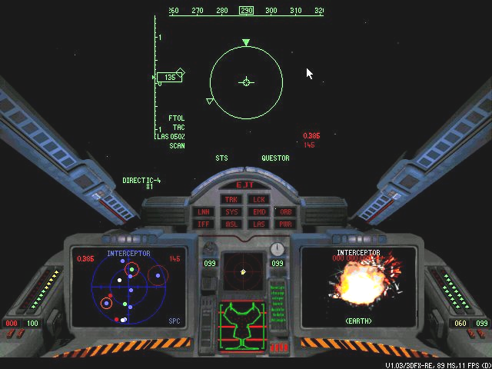
BATTLECRUISER: 3000AD
1998 space simulation game
'I am a Gammulan Criminal up against a Terran EarthCOM ship. My ship is 50% damaged but my weapon systems are fully functional and my goal is still unresolved' what do I do?

Slide 7

Black and White
Player dictates good or bad creature behavior
Uses neural networks to teach the creature behaviors

Slide 8
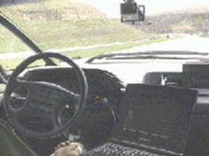


ALVINN drives 70mph on highways

Slide 9
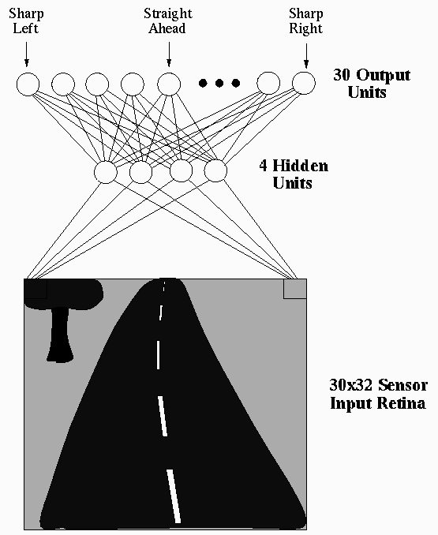
ALVINN drives 70mph on highways

Slide 10






Classification problem
Imagine that there are two groups patterns:
  One group is classified as A
  The other classified as B
The Problem:
How can computer learn to correctly classify the input patterns:
  Those that were seen before
  Those that were not seen before.
Not an easy problem!!
A/B ??

Slide 11
Classification problem
Imagine that there are two groups patterns: One group is classified as A whereas the other classified as B
Not an easy problem!

Slide 12
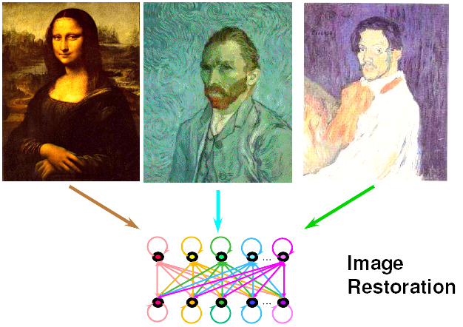
Robust Pattern Recognition & Image Restoration

Slide 13
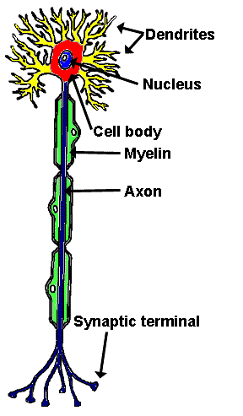
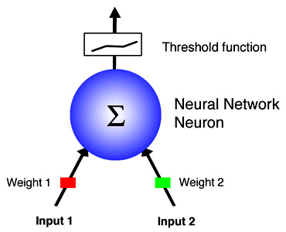
Neurons
Biological
Artificial (Perceptron)
http://research.yale.edu/ysm/images/78.2/articles-neural-neuron.jpg

Slide 14
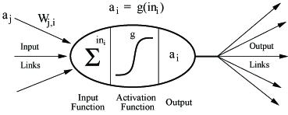
Neural Network Neurons
Receives n-inputs
Multiplies each input by its weight
Applies activation function to the sum of results
Outputs result
http://www-cse.uta.edu/~cook/ai1/lectures/figures/neuron.jpg

Slide 15
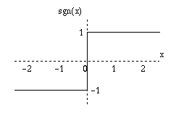
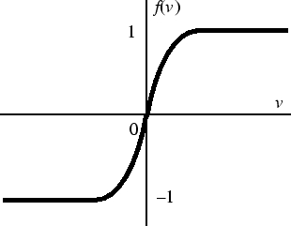
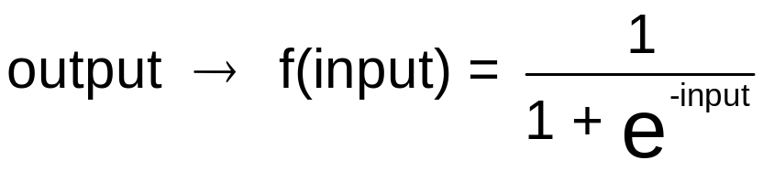
Activation Functions
Controls when unit is “active” or “inactive”
Threshold function outputs 1 when input is positive and 0 otherwise
Sigmoid function

Slide 16
Boolean AND
Y => Threshold Function
y
input x1 | input x2 | ouput
0 | 0 | 0
0 | 1 | 0
1 | 0 | 0
1 | 1 | 1
w₀= −1.5
X₀ = 1
w₁=1
w₂=1
x₁
x₂
X0 | X1 | X2 | S | y
1 | 0 | 0 | - 1.5 | 0
1 | 0 | 1 | - 0.5 | 0
1 | 1 | 0 | - 0.5 | 0
1 | 1 | 1 | + 0.5 | 1
S = 1*-1.5 + 0*1 + 0*1 = -1.5
S = 1*-1.5 + 0*1 + 1*1 = -0.5
S = 1*-1.5 + 0*1 + 1*1 = -0.5
S = 1*-1.5 + 1*1 + 1*1 = +0.5

Slide 17
Boolean OR
Y => Threshold Function
y
input x1 | input x2 | ouput
0 | 0 | 0
0 | 1 | 1
1 | 0 | 1
1 | 1 | 1
w₀= −0.5
X₀ = 1
w₁=1
w₂=1
X₁
X₂
X0 | X1 | X2 | S | y
1 | 0 | 0 | - 0.5 | 0
1 | 0 | 1 | + 0.5 | 1
1 | 1 | 0 | + 0.5 | 1
1 | 1 | 1 | + 1.5 | 1

Slide 18
Inverter (Boolean NOT)
y
input x1 | output
0 | 1
1 | 0
Y => Threshold Function
w₀= 0.5
X₀ = 1
w₁= -1
w₂=1
X0 | X1 | S | y
1 | 0 | + 0.5 | 1
1 | 1 | - 0.5 | 0
X₁
X₂ = 0

Slide 19
Boolean XOR
input x1 | input x2 | ouput
0 | 0 | 0
0 | 1 | 1
1 | 0 | 1
1 | 1 | 0
y
Eeek!
X₀ = ?
x₁
x₂

Slide 20
Linear Separability
x₂
+
+
OR
x₂
−
+
x₁
−
+
x₂
?
AND
x₁
+
−
−
−
XOR
x₁
−
+

Slide 21
Boolean XOR
input x1 | input x2 | ouput
0 | 0 | 0
0 | 1 | 1
1 | 0 | 1
1 | 1 | 0
XOR
o
-0.5
1
1
-1
OR
AND
h₁
h₂
-0.5
1
-1.5
1
h₁, h₂, o => Threshold Function
1
1
1
1
x₁
x₂

Slide 22
A Feed-forward Network
I₁
X₁
H₁
Y₁
O₁
I₂
X₂
H₂
Y₂
O₂
I₃
X₃
X₄
H₃
I₄
Input Layer
Hidden Layer
Output Layer

Slide 23
A Feed-forward Network
y₁
…
y_{m}
Output Layer
u_{j1}
u_{1m}
u₁₁
u_{l1}
u_{j1}
u_{lm}
b₁
…
b_{l}
…
b_{j}
Hidden Layer
v₁₁
v_{1l}
v_{kl}
v_{il}
v_{ij}
v_{1j}
v_{k1}
v_{kj}
v_{i1}
a₁
…
a_{k}
…
a_{i}
w₁₁
w_{1k}
w_{nk}
w_{ni}
Input Layer
w_{n1}
w_{1i}
x₁
…
x_{n}

Slide 24
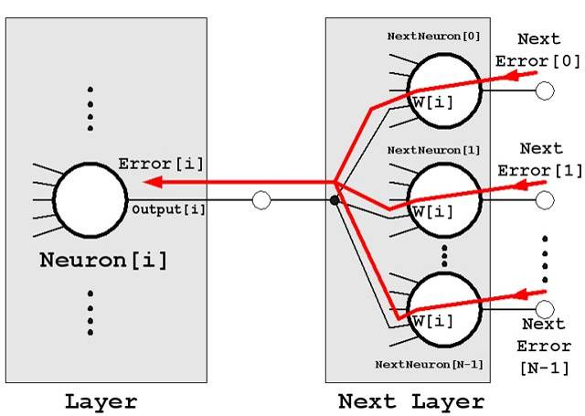
Weights: How to learn?
Backpropagation Algorithm

Slide 25
Backpropagation
Create the network.
Initialize the weights to small random values with a mean of 0.
For each training pattern (random sequence):
  Present to the network and evaluate the output
  Calculate the error value for the neurons in the output layer
  Adjust the weights of the output layer
  Calculate the error value for neurons in the hidden layer
  Adjust the weights of the hidden layer
Repeat Step 3 until the error is below an acceptable value.
Epoch

Slide 26
Calculate the error & adjust the weights
b: Calculate the error for the neurons in the output layer
    E_{k} = Error value output unit k
    t_{k} = Target output for unit k
    o_{k} = Output from output layer unit k
c: Adjust the weights in the output layer.
    W_{jk} = Weight between hidden layer unit j and output layer unit k
    L = Learning Rate, small positive value (user input)
    o_{j} = Output from hidden layer unit j

Slide 27

Calculate the error & adjust the weights
d: Calculate the error value for neurons in the hidden layer
    E_{j} = Error value hidden layer unit k
    n = number of neuron unit in the output layer.
e: Adjust the weights in the output layer.
    W_{ij} = Weight between input layer unit i and hidden layer unit j
    o_{i} = Output from input layer unit i

Slide 28
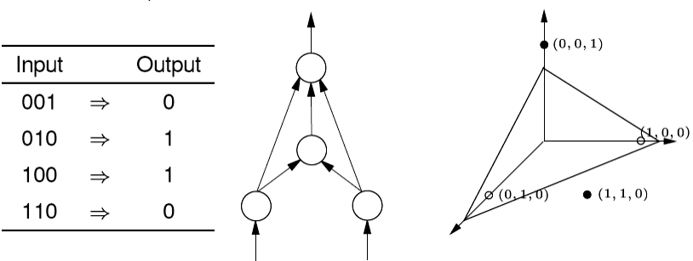
Example: XOR
XOR Training Set
Activation Function → Sigmoid Function
input x1 | input x2 | Ouput (target)
0 | 0 | 0
0 | 1 | 1
1 | 0 | 1
1 | 1 | 0
4
Wb₁
2
0
-1
3
1
0
W₂
W₁
0
W₃
0
Randomize Data Training Sequence
0
W₅
W₄
0
0
Wb₂
X₁
X₂
-1

Slide 29
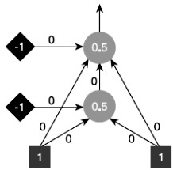
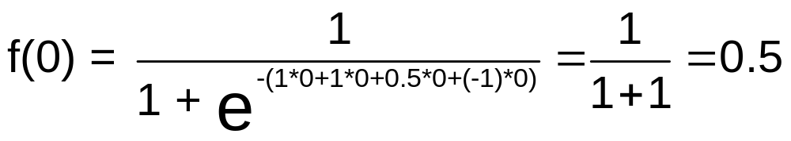
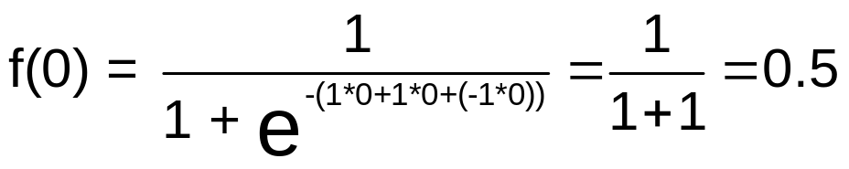
Example: XOR
Epoch 1; Iteration 1
Data Training = (1, 1); Target t = 0; Assume: Learning Rate L = 0.1
Present to the network and evaluate the output (Feed-forward phase).

Slide 30
Example: XOR
Data Training = (1, 1); Target t = 0; Assume: Learning Rate L = 0.1
Calculate the error value for the neurons in the output layer
E_{out} = (t – o_{out}) * o_{out} (1 – o_{out})
= (0 – 0.5) × 0.5 × (1 – 0.5) = -0.125
Adjust the weights of the output layer
New weight = Old weight + L * E_{out} * o_{hid}
New W₁ = 0 + 0.1 * -0.125 * 1 = -0.0125
New W₂ = 0 + 0.1 * -0.125 * 0.5 = -0.00625
New W₃ = 0 + 0.1 * -0.125 * 1 = -0.0125
New Wb₁ = 0 + 0.1 * -0.125 * -1 = 0.0125

Slide 31

Example: XOR
Calculate the error value for neurons in the hidden layer
E_{hid} = o * (1 – o) * E_{out} * W₂
= 0.5 * (1 – 0.5) * -0.125 * -0.00625 = 0.000195
Adjust the weights of the hidden layer
New weight = Old weight + L * E_{hid} * input
New W₄ = 0 + 0.1 * 0.000195 × 1 = 0.0000195
New W₅ = 0 + 0.1 * 0.000195 × 1 = 0.0000195
New Wb₂ = 0 + 0.1 * 0.000195 × -1 = -0.0000195

Slide 32
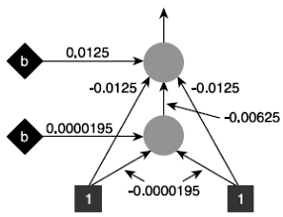
Example: XOR
After the first iteration
Output of the updated network = 0.489845.
  A little bit closer to the target (0) than the original output (0.5).
-0.0000195

Slide 33
Example: XOR
  Iteration 2: Data Training = (0,1); Target t = 1
  Iteration 3: Data Training = (1,0); Target t = 1
  Iteration 4: Data Training = (0,0); Target t = 0
Is the output error is below 0.001 ? If True ⇒ STOP Training and save the last weights.
If False ⇒ Epoch 2
  Randomize Data Training Sequence
  Assume: The sequence ⇒ (1,0), (0,0), (0,1), (1,1)
  Iteration 1: Data Training = (1,0); Target t = 1
  Iteration 2: Data Training = (0,0); Target t = 0
  Iteration 3: Data Training = (0,1); Target t = 1
  Iteration 4: Data Training = (1,1); Target t = 0
Is the output error is below 0.001 ? If True ⇒ STOP Training save the last weights.
If False ⇒ Epoch 3

